Slide 1
Improvement of Energy Efficiency with a new power source allocation scheme based on non-linear Energy Harvesting model
Yanbo Liu
Background
Explanation
Results
Evaluation and Future Plan

Slide 2
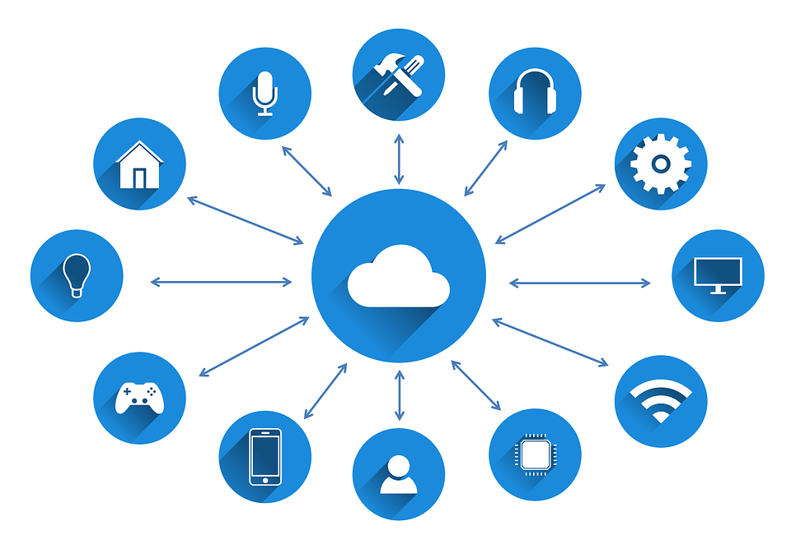
IOT

Slide 3
Benefit from IOT
1. Improved productivity of staff and reduced human labour
2.Better use of resources and assets
3.improved customer service and retention

Slide 4
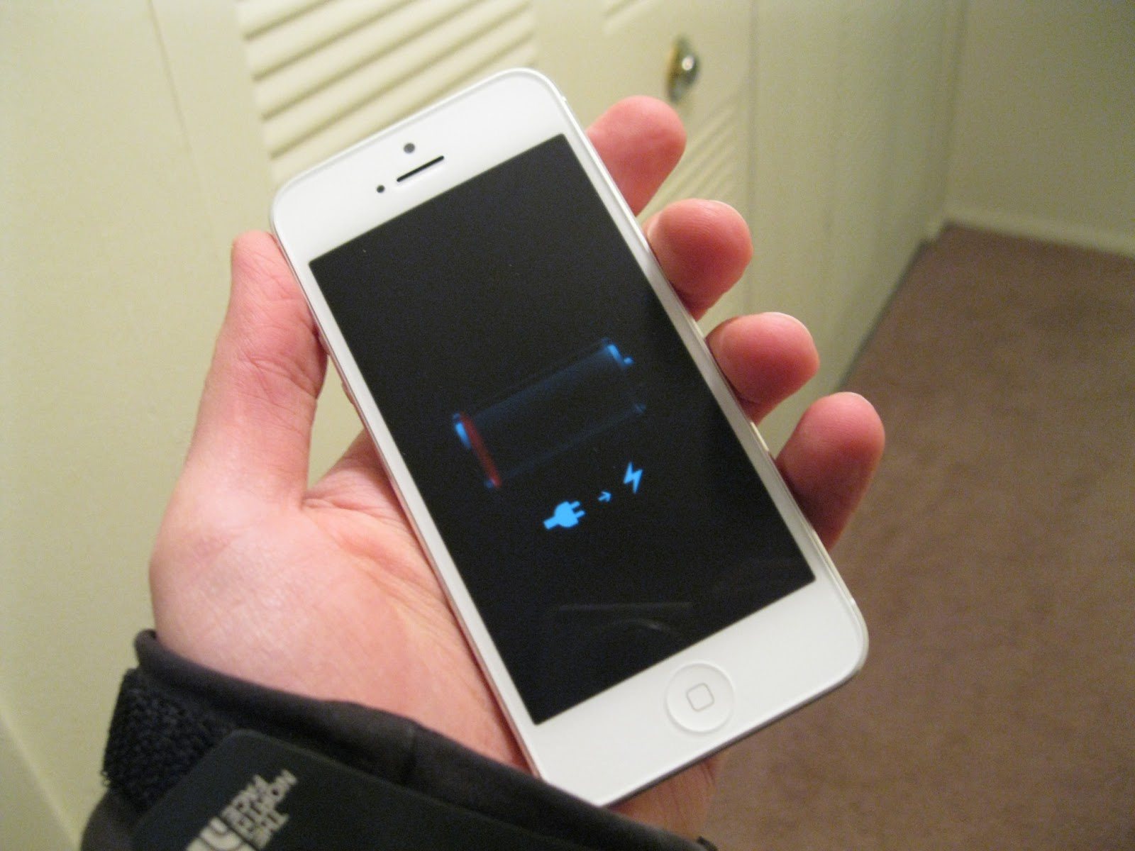
Problem of IOT: Low Energy Efficiency
Caused by
1.Limited built-in battery lifetime
This Photo by Unknown Author is licensed under CC BY-NC

Slide 5
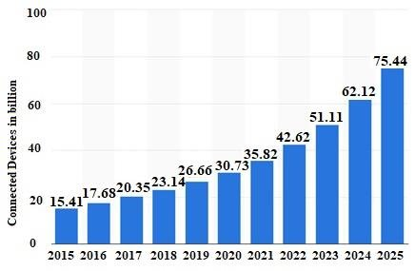
There will be over 75 billion connected devices in IOT Network by 2025..

Slide 6

Is it possible for mobile devices to charge themselves?

Slide 7

Fortunately, we have SWIPT!!!

Slide 8
Simultaneous Wireless Information and power transfer(SWIPT)
1.It allows the mobile devices to harvest energy from ambient environment to charge the built-in batteries
2.It can exploit the useless mutual interference power for the IOT system.

Slide 9
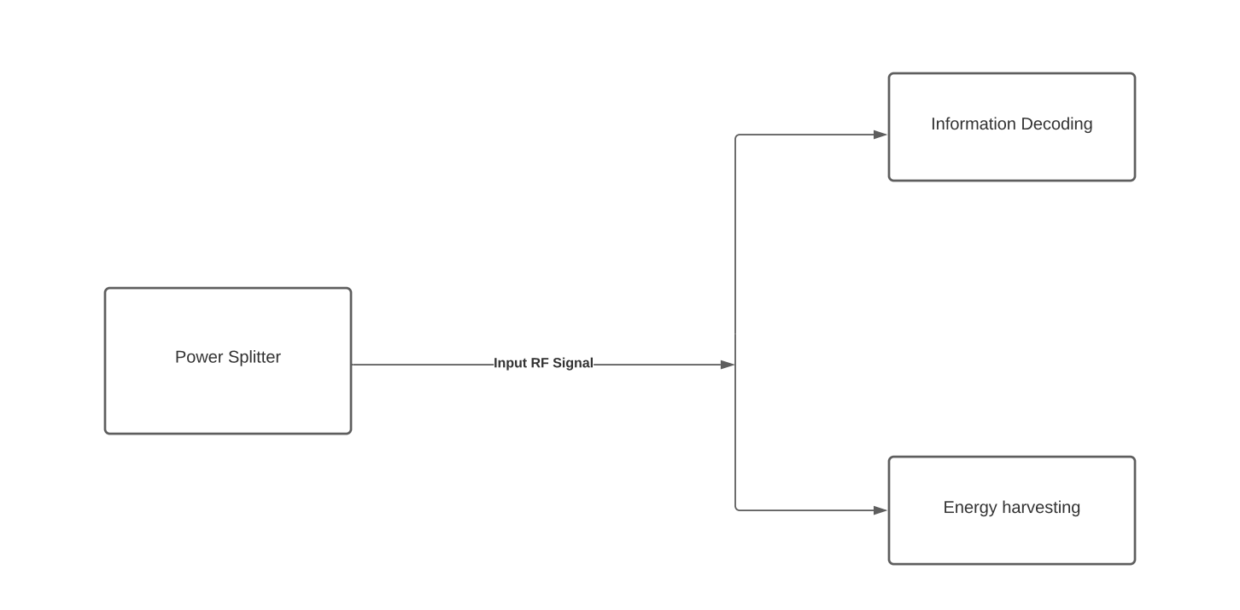

Slide 10
Device-to-Device communication system(D2D)
1.It allows two users in proximity to communicate with each other directly without passing through the base station by reusing the spectrum resource

Slide 11
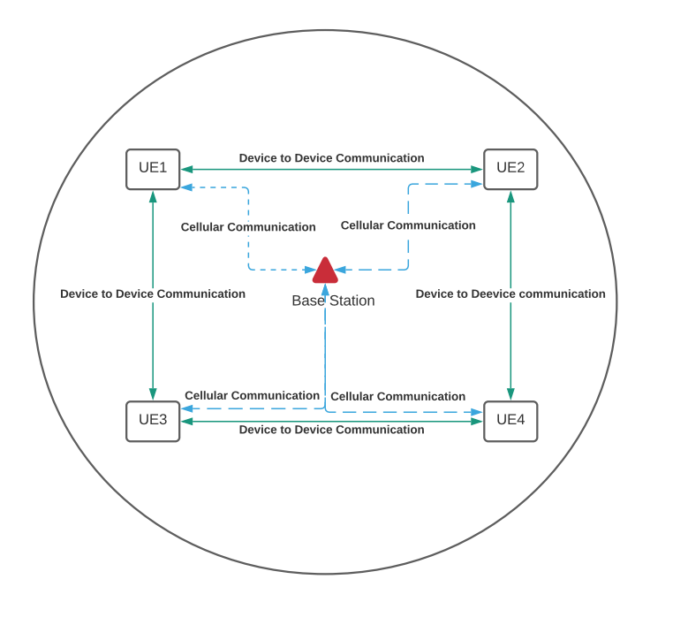

Slide 12


But, it is impossible that all the D2D links can perform SWIPT....
Because of
1.Channel Condition
2.Throughput requirement
Is there a method we can use to find those D2D links that can perform SWIPT?

Slide 13
D2D links
Cellular User Equipment (CUE)

Slide 14
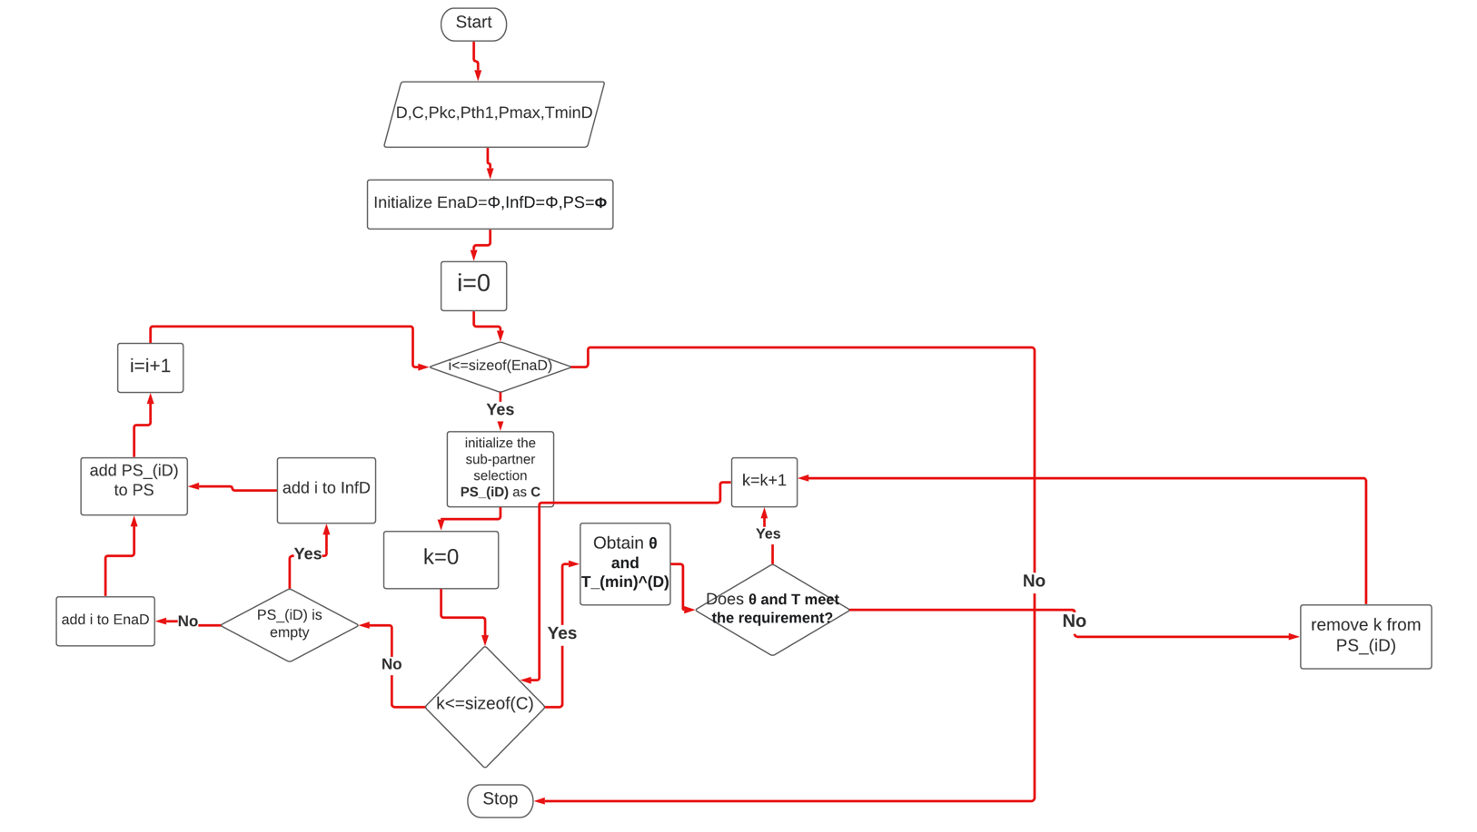
Pre-Matching

Slide 15

Throughput and Power splitting ratio requirement
$θ_{i,min}=\frac{P_{thresold}^{1}}{P_{max}h_{i}^{D}+P_{k}^{c}h_{k,i}+N_{0}}$
$T_{i}^{D}=\frac{P_{i}^{D}h_{i}^{D}}{P_{k}^{C}h_{k,i}+N_{0}+\frac{N_{1}}{1−θ_{i,min}}}$

Slide 16
After using Pre-Matching.....
The Entire D2D group
EnaD
InfD

Slide 17
Now we have those D2D links which can perform SWIPT!!!

Slide 18
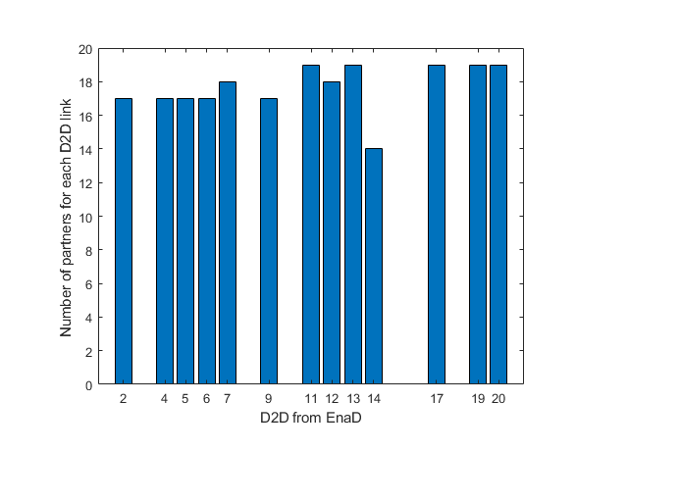
But it is noted that for each D2D link i, it will have more than one CUE partner k.....

Slide 19
Target: Help each D2D link find it best partner CUE to maximize its Energy Efficiency
IiI want my CUE partner to help me achieve maximum EE!!
CUE
D2D

Slide 20

EE definition
$EH_{i}^{D}=\left\{\begin{aligned}0, \\ k_{j}P_{i}^{R}+b_{j}, \\ P_{max}^{harvested},\end{aligned}\right.\begin{matrix} P_{i}^{R}∈[P_{thresold}^{0},P_{thresold}^{1}] \\ P_{i}^{R}∈[P_{thresold}^{j},P_{thresold}^{j+1}] \\ P_{i}^{R}∈[P_{thresold}^{L},P_{thresold}^{L+1}]\end{matrix}$
$P_{i}^{R}=θ_{i}\left(P_{i}^{D}h_{i}^{D}+P_{k}^{c}h_{k,i}+N_{0}\right)$
EE=$\frac{T_{i}^{D}}{EC_{i}^{D}}=$ $\frac{log2\left(1+\frac{\left(1−θ_{i }\right)P_{i}^{D}h_{i}^{D}}{\left(1−θ_{i}\right)\left(P_{k}^{c}h_{k,i}+N_{0} \right)+N_{1}}\right)}{P_{i}^{D}+2P_{circuit}−EH_{i}^{D} }$

Slide 21

Formulation of each D2D link’s EE maximization problem
$C1:\max_{θ_{i},P_{i}^{D}, i∈EnaD}{EE_{i}^{D}}$
$\begin{matrix}N1: \\ N2: \\ N3:\end{matrix}\begin{matrix} 0<P_{i}^{D}<P_{max} \\ 0≤θ_{i}≤1 \\ T_{i}^{D}≥T_{min}^{D}\end{matrix}$
$\begin{matrix}N4: \\ N5: \\ N6:\end{matrix}\begin{matrix}T_{k}^{C}≥T_{min}^{C} \\ P_{i}^{R}≥P_{thresold}^{1} \\ { P}_{thresold}^{j}≤P_{i}^{R}≤P_{thresold}^{j+1}\end{matrix}$
$C2:\max_{θ_{i},P_{i}^{D},i∈EnaD}{T_{i}^{D}−G_{i}^{D}EC_{i}^{D}}$
s.t. $N1−N6$

Slide 22

Lagrange function and Lagrange multipliers
$L(P_{i}^{D},θ_{i},α,β,γ,δ,σ) =T_{i}^{D}−G_{i}^{D}EC_{i}^{D}−α\left(P_{i}^{D}−P_{max}\right)−β\left(θ_{i}−1\right)+γ\left(T_{i}^{D}−T_{min}^{D}\right) +δ\left(T_{i}^{C}−T_{min}^{C}\right)+σ(P_{i}^{R}−P_{thresold }^{1})$
$\begin{matrix} α={\left\{α+s_{1}\left(P_{i}^{D}−P_{max}\right)\right\}}^{+} \\ β={\left\{β+s_{2}\left(θ_{i}−1 \right)\right\}}^{+} \\ γ={\left\{γ+s_{3}\left(T_{i}^{D}−T_{min}^{D}\right)\right\}}^{+} \\ δ={\left\{δ+s_{4}\left(T_{i}^{C}−T_{min}^{C}\right)\right\}}^{+} \\ σ={\left\{σ+s_{5}\left(P_{i}^{R}−P_{thresold }^{1}\right)\right\}}^{+}\end{matrix}$

Slide 23
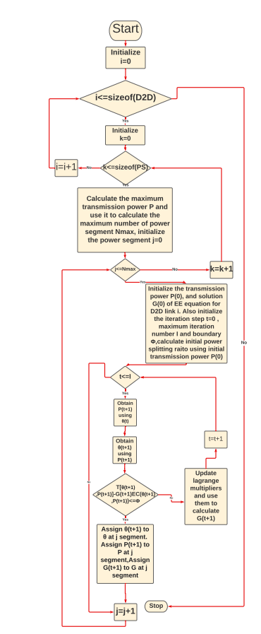
Inner Loop

Slide 24
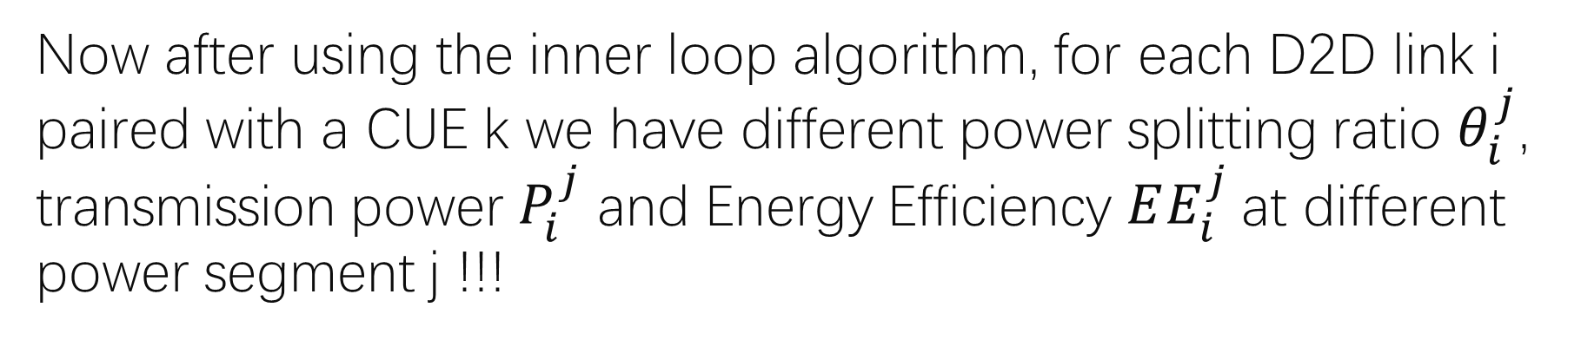
Now after using the inner loop algorithm, for each D2D link i paired with a CUE k we have different power splitting ratio $θ_{i}^{j}$, transmission power $P_{i}^{j}$ and Energy Efficiency $EE_{i}^{j}$at different power segment j !!!
D2D link i
CUE k
Power segment j

Slide 25
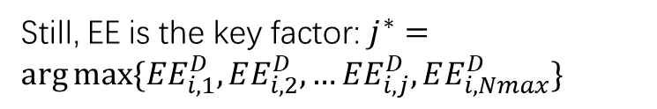
Now we need to find the best power segment for each so that we can find the best partner for each D2D link i
Still, EE is the key factor: $j^{∗}=\arg{max⁡\{EE_{i,1}^{D},EE_{i,2}^{D},…EE_{i,j}^{D},EE_{i,Nmax}^{D}\}}$

Slide 26
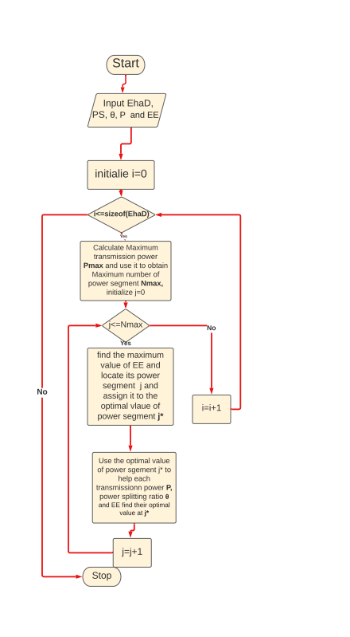
Outer Loop

Slide 27
Good!! Now we have the best power segment for each D2D link i paired with a CUE k.
Optimal power segment j*
D2D link i
CUE k

Slide 28

Now since each D2D i paired with CUE k has its best power segment, we can then find i’s best partner..
I want my CUE partner to help me find the maximum EE!!
Well, I want my partner to have the least interference power from me!!!!
CUE k
D2D link i

Slide 29

Interference power
$P_{interference}=P_{i}^{D}h_{i}^{B}$

Slide 30
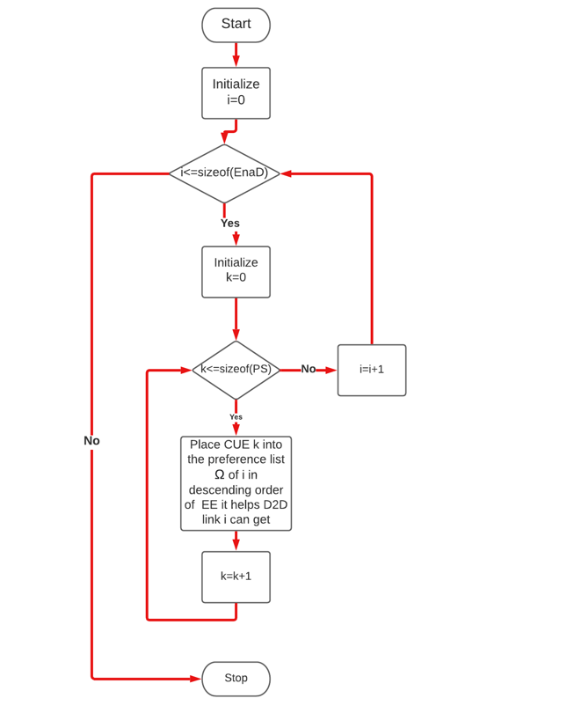
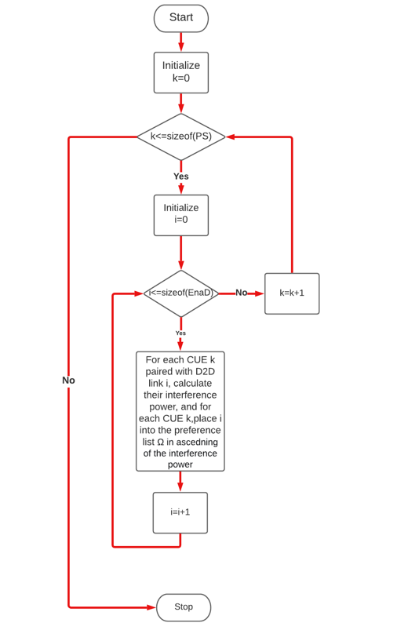
Preference list
List for each D2D link i
List for each CUE k

Slide 31
After building the preference list....
D2D link i
CUE k
CUE 1
CUE2
CUE3
D2D 1
D2D2
D2D3
They were all placed in descending order of EE
They were all placed in ascending order of Interference power

Slide 32
Now we want to find the each D2D link i’s best partner CUE k
D2D link i
CUE k
D2D 1
D2D2
D2D3
CUE 1
CUE 2
CUE 3

Slide 33
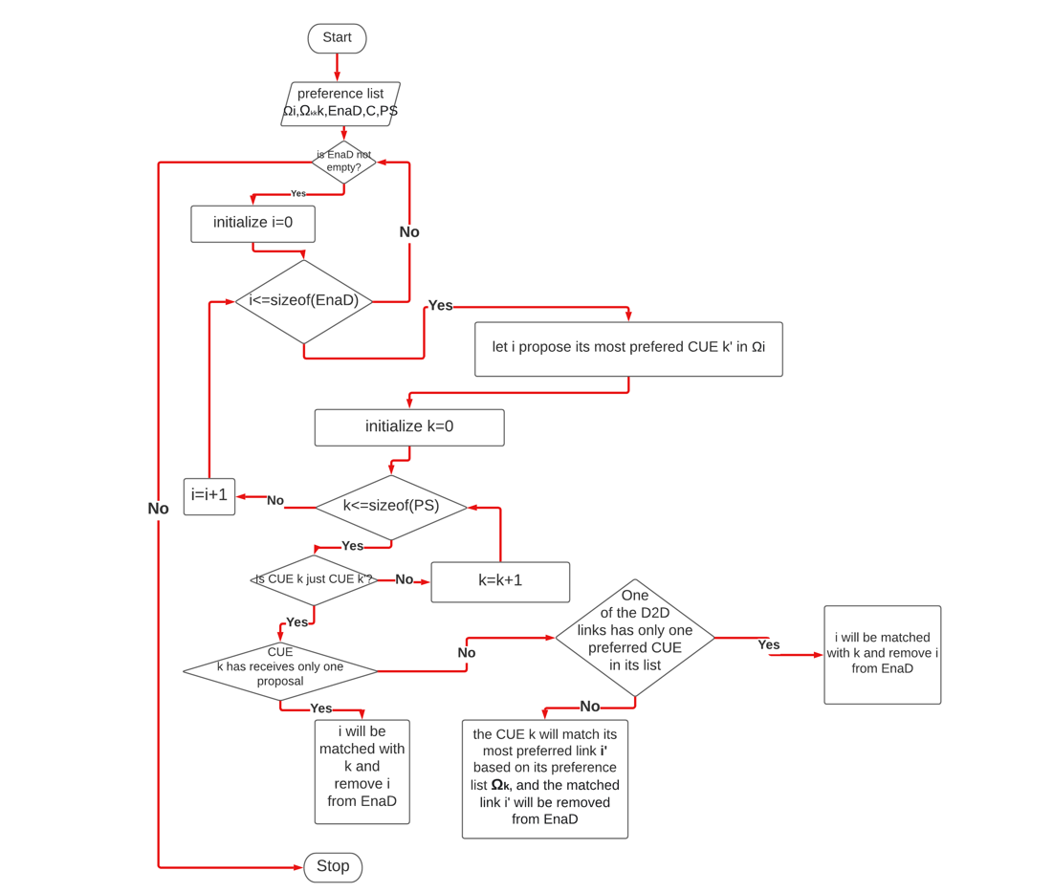
One to one stable Matching

Slide 34
After using one-to-one stable matching, each D2D link i will find its best partner CUE k which can help it obtain the maximum EE.
D2D link i
CUE k

Slide 35
Result
Pre-Matching Failure Rate for different number of D2D links
2. Pre-Matching Failure Rate for different number of D2D links with different threshold power limit
3. Pre-Matching Failure Rate for different communication distance
4. Pre-Matching Failure Rate for different communication distance with different threshold power limit

Slide 36

Pre-Matching Failure Rate(PMFR)
$PMFR=\frac{number of D2D links in InfD}{total number of D2D links}$

Slide 37
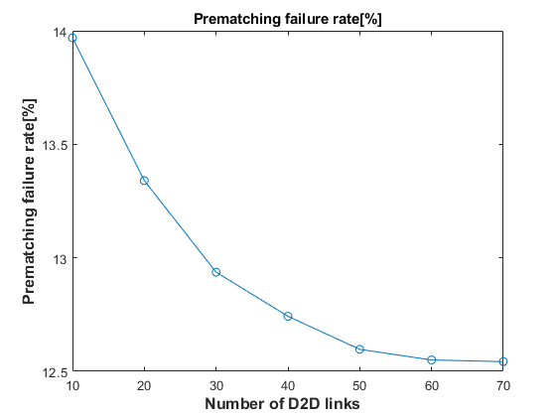
Pre-Matching Failure Rate for different number of D2D links

Slide 38
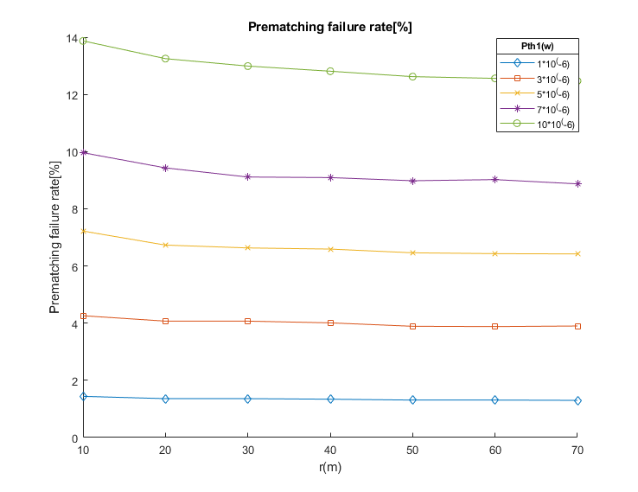
Pre-Matching Failure Rate for different number of D2D links with different threshold power limit

Slide 39
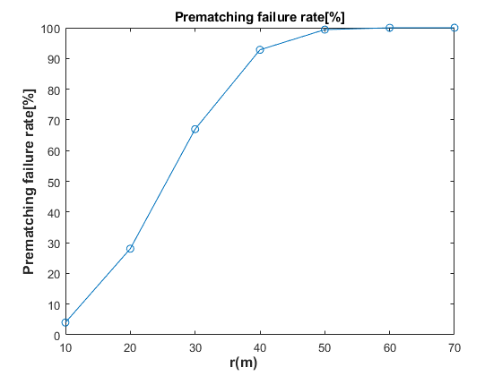
Pre-Matching Failure Rate for different communication distance

Slide 40
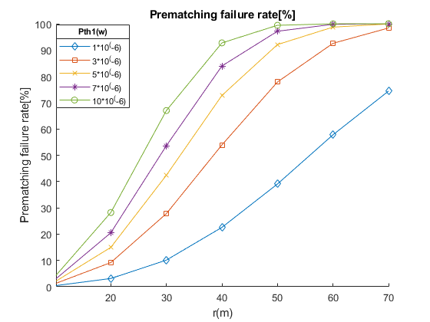
Pre-Matching Failure Rate for different communication distance with different threshold power limit

Slide 41
Evaluation

Slide 42
Difficulties
1.Literature Review: technical concepts like SWIPT, D2D communication and so on
2. Math: Optimization theory, fractional Programming..
3. Communication: Communication with the authors of the reference paper
4. MATLAB Limitation

Slide 43
Summary
1. The result is basically the same as expected.
2. The work is performed following the date established in the modified Gannt Chart

Slide 44
Future Plan
1.Simulation of the rest of the algorithms
2. Solve the parameters initialization issues from the reference paper
3.Optimization of implemented Algorithms

Slide 45
Thanks for listening!!
此照片，作者: 未知作者，许可证: CC BY-SA

